Slide 1
Information Security Public and Private Key Algorithms
Lecture 10
Razia Nisar Noorani &
Dr. Amir Mehmood

Slide 2
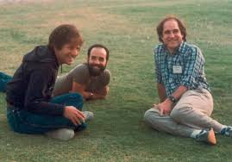
RSA Public Key Encryption Algorithm
The best known public key cryptosystem is RSA - named after its authors, Rivest, Shamir and Adelman

Slide 3
RSA
RSA - named after Rivest, Shamir and Adleman, the inventors - was the first public-key scheme which was capable of signatures as well as encryption.
It is the easiest to understand as well as the most popular to implement
RSA obtains its security from the difficulty of factoring large numbers.

Slide 4
Encryption with RSA
To encrypt a plaintext message block m, compute
C=Me mod n
To decrypt the block, compute
M=C^{d} mod n
Each plaintext block must be smaller than the value of n.

Slide 5
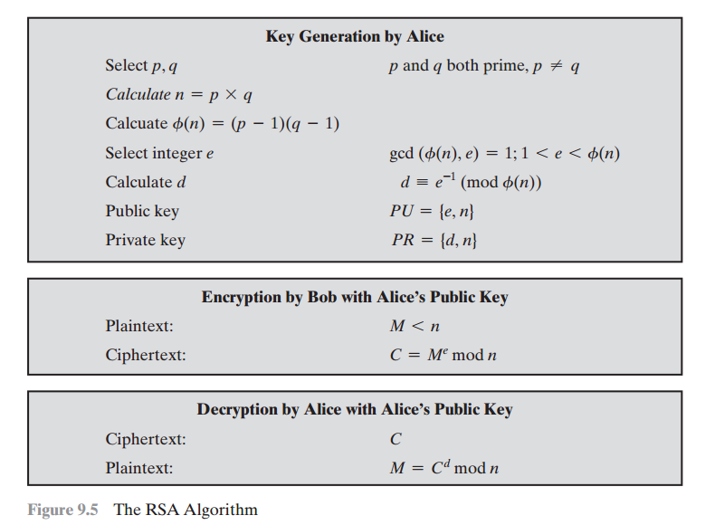
d=(1*24)+1/5
d=25/5=5

Slide 6
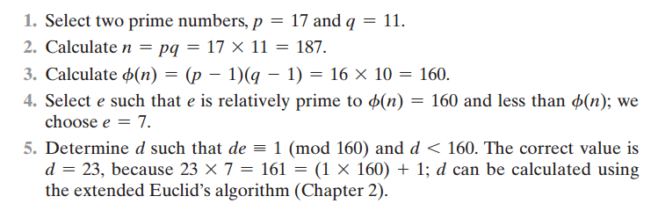
= m
de = (1+mx) = d= (1+160x)/7

Slide 7
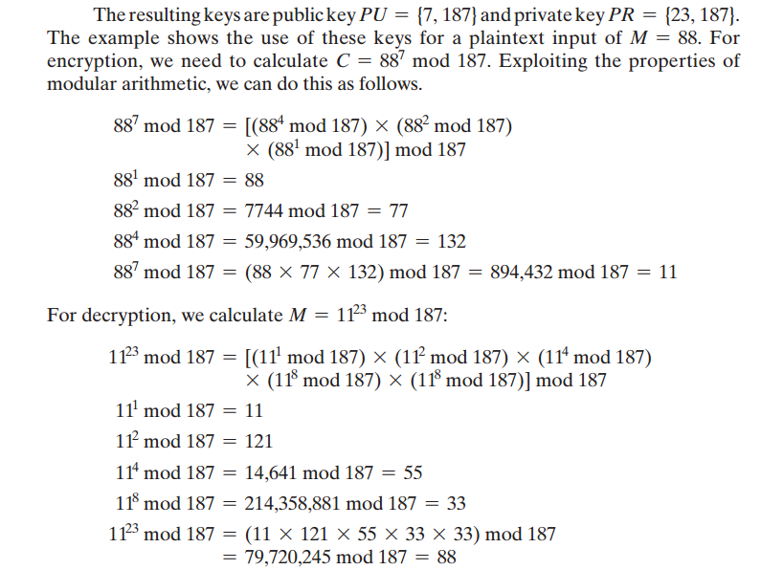

Slide 8
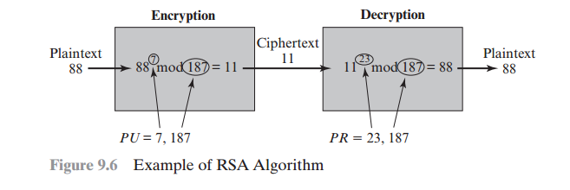
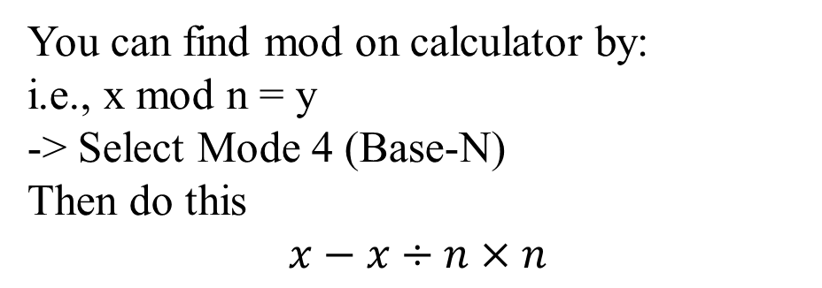

Slide 9
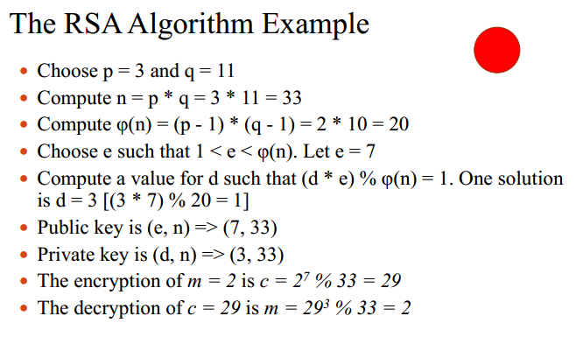
=m
d = [1+(x*m)] / e => d=[1+ (1*20)] / 7 =3

